Slide 1


Slide 2
Apache Spark
Apache Spark is an open-source cluster computing framework. Its primary purpose is to handle the real-time generated data.
Spark was built on the top of the Hadoop MapReduce. It was optimized to run in memory whereas alternative approaches like Hadoop's MapReduce writes data to and from computer hard drives. So, Spark process the data much quicker than other alternatives.

Slide 3
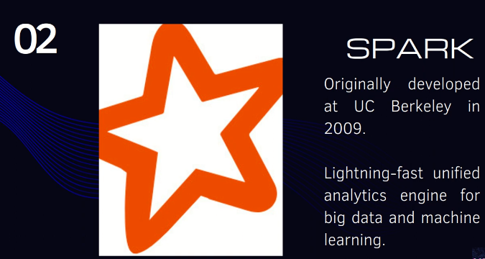

Slide 4


Slide 5
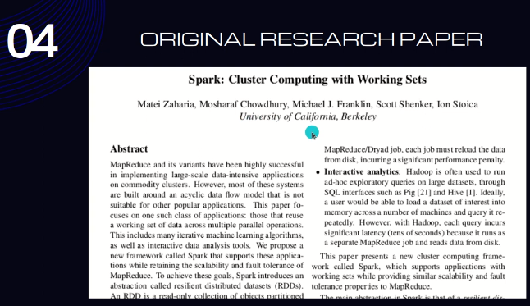
hotcloud_spark.pdf (mit.edu)

Slide 6
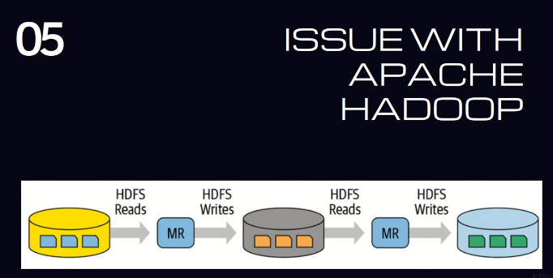

Slide 7
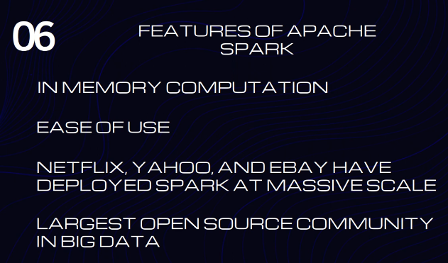

Slide 8
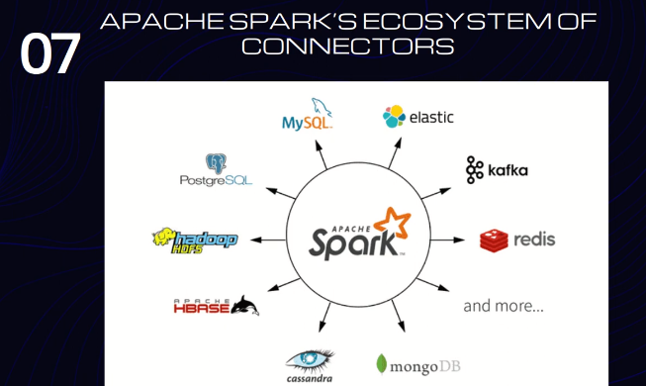

Slide 9
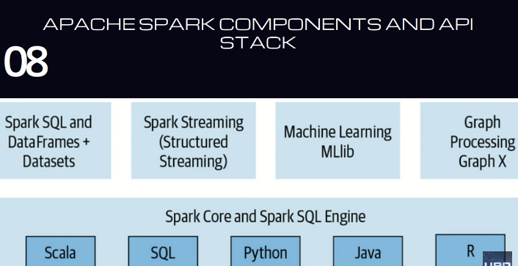

Slide 10
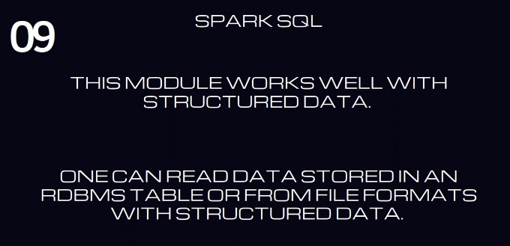

Slide 11
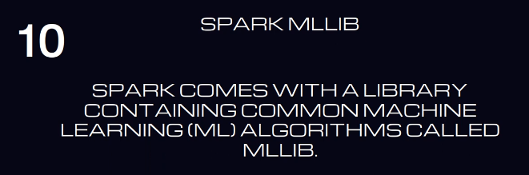

Slide 12
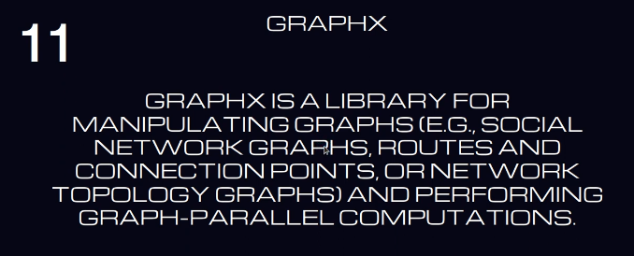

Slide 13
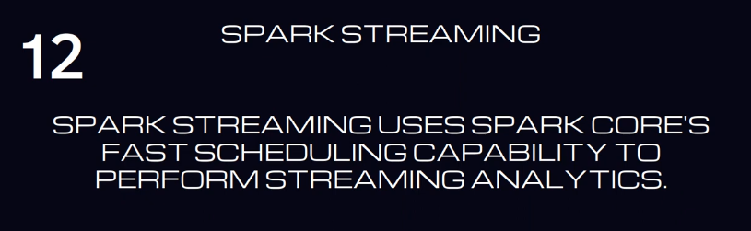

Slide 14
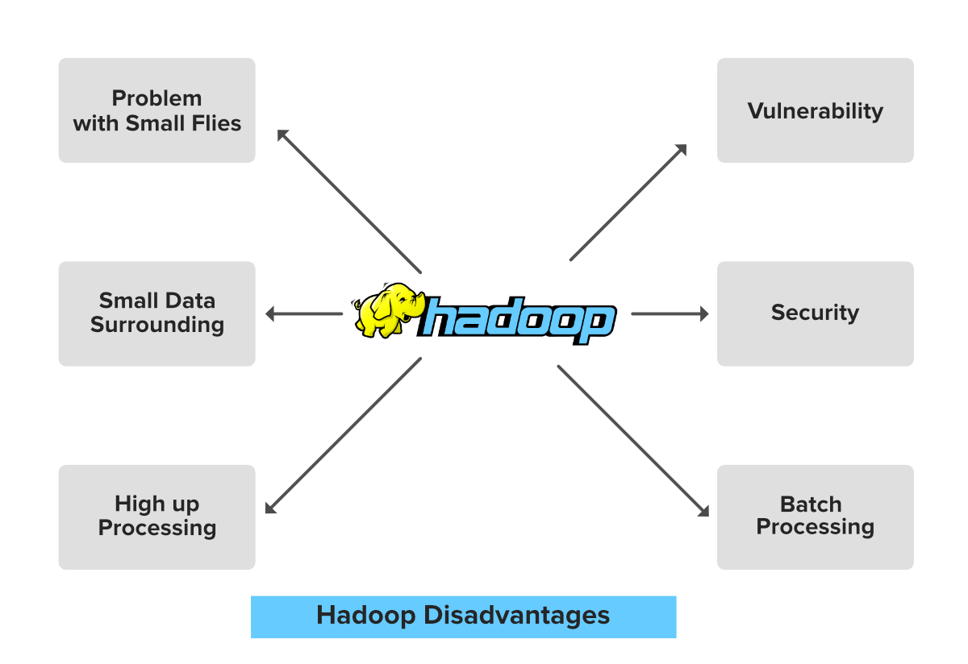
Limitations of Hadoop

Slide 15
1. Problem with Small files
Hadoop can efficiently perform over a small number of files of large size. Hadoop stores the file in the form of file blocks which are from 128MB in size(by default) to 256MB.
Hadoop fails when it needs to access the small size file in a large amount. This so many small files surcharge the Namenode and make it difficult to work.

Slide 16
2. Vulnerability
Hadoop is a framework that is written in java, and java is one of the most commonly used programming languages which makes it more insecure as it can be easily exploited by any of the cyber-criminal.

Slide 17
3. Low Performance In Small Data Surrounding
Hadoop is mainly designed for dealing with large datasets, so it can be efficiently utilized for the organizations that are generating a massive volume of data.
It’s efficiency decreases while performing in small data surroundings.

Slide 18
4. Lack of Security
Data is everything for an organization, by default the security feature in Hadoop is made un-available. So the Data driver needs to be careful with this security face and should take appropriate action on it.
Hadoop uses Kerberos for security feature which is not easy to manage. Storage and network encryption are missing in Kerberos which makes us more concerned about it.

Slide 19
5. High Up Processing
Read/Write operation in Hadoop is immoderate since we are dealing with large size data that is in TB or PB.
In Hadoop, the data read or write done from the disk which makes it difficult to perform in-memory calculation and lead to processing overhead or High up processing.

Slide 20
6. Supports Only Batch Processing
The batch process is nothing but the processes that are running in the background and does not have any kind of interaction with the user.
The engines used for these processes inside the Hadoop core is not that much efficient. Producing the output with low latency is not possible with it.

Slide 21
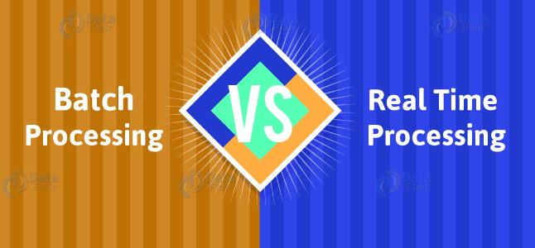
Data Processing

Slide 22
Batch Processing
In this process, At first, data is collected, entered and processed. Afterward, it produces batch results.
We can say HADOOP works on batch data processing. For input, process, and output, batch processing requires separate programs.
Payroll and billing systems are beautiful examples of batch processing.

Slide 23
Advantages of Batch Processing
Batch Processing is Ideal for processing large volumes of data/transaction. It also increases efficiency rather than processing each individually.
Here, we can do processing independently. Even during less-busy times or at a desired designated time.
For the organization by carrying out the process, it also offers cost efficiency.
Also, allows a good audit trail.

Slide 24
Disadvantages of Batch Processing
The time delay between the collection of data and getting the result after the batch process.
In the batch processing master file is not always kept up to date.
Here, a one-time process can be very slow.

Slide 25
Real-Time Processing
Real-Time Processing involves continuous input, process, and output of data. Hence, it processes in a short period of time.
There are some programs which use such data processing type.
For example, bank ATMs, customer services, radar systems, and Point of Sale (POS) Systems. Every transaction is directly reflected in the master file, with this data process. So, that it will always be up-to-date.

Slide 26
If you want analytics results in real time, Spark Real-Time processing is key. We can feed data into analytics tools, by building data streams, as soon as it is generated.
Moreover, it gets near-instant analytics results by using platforms like spark streaming.

Slide 27
Advantages of Real-Time Processing
While performing real-time processing, there is no significant delay in response.
In real-time processing, information is always up to date. Hence, it makes the organization able to take immediate action. Also, when responding to an event, issue or scenario in the shortest possible span of time.
It also makes the organization able to gain insights from the updated data. Even helps to detect patterns of possible identification of either opportunities or threats.

Slide 28
Disadvantages of Real-Time Processing
Real-Time processing is very complex as well as expensive processing.
Also turns out to be very difficult for auditing.
Real-Time processing is a bit tedious processing.

Slide 29
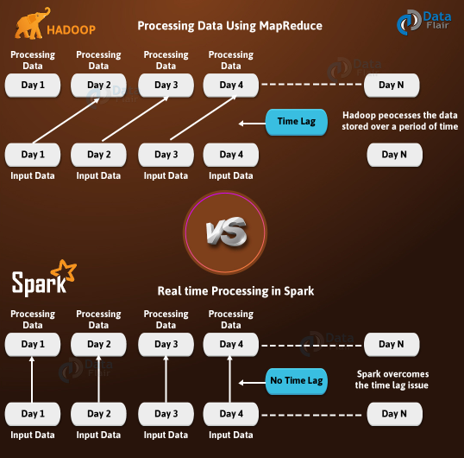

Slide 30
Stream Processing
Stream processing and in-memory processing are two techniques that can enable fast and scalable data analysis in real-time.
Stream processing is the method of processing data on the fly, as it arrives from various sources, without storing it first.

Slide 31
Applications of Stream Processing
Real-time Analytics: Stream processing is extensively used for real-time analytics in industries such as finance, e-commerce, and online advertising. It allows organizations to analyze data as it's generated, making it possible to make quick decisions based on up-to-the-moment information.
Fraud Detection: Financial institutions and e-commerce companies use stream processing to detect fraudulent activities in real-time. Analyzing transaction data as it flows through the system helps identify unusual patterns and flag potential fraud.
IoT Data Processing: In the Internet of Things (IoT) space, stream processing is essential for processing the vast amounts of data generated by sensors and devices in real time. This enables applications like smart cities, predictive maintenance, and environmental monitoring.
Social Media Monitoring: Stream processing is used to monitor and analyze social media feeds in real time. Companies can track brand mentions, sentiment analysis, and emerging trends as they happen.

Slide 32
In-memory Processing
In-memory processing is the practice of taking action on data entirely in computer memory (e.g., RAM), without reading or writing it to slower media such as disk drives.
Both techniques aim to reduce the latency and increase the performance of data processing.

Slide 33
Applications of In-memory Processing
Database Caching: In-memory databases store data in system memory (RAM) rather than on disk. This allows for extremely fast data retrieval, making it ideal for applications requiring quick access to frequently used data, such as transaction processing systems.
Data Warehousing: In-memory processing is used in data warehousing solutions to accelerate query performance. It allows for the rapid retrieval and analysis of large volumes of data for reporting and business intelligence purposes.
Recommendation Engines: In-memory processing is employed in recommendation systems (e.g., for e-commerce or content platforms) to store and retrieve user profiles and product/content catalogs quickly, providing personalized recommendations.
Simulation and Modeling: In scientific and engineering applications, in-memory processing accelerates simulations and modeling by allowing large datasets to be stored in memory, reducing processing time.

